Slide 1


AAVSB BOARD OUTREACH / JUNE 2026
THE AAVSB: CONNECTING THE REGULATORY COMMUNITY
Mark Chmielewicz, DVM, AAVSB BOARD OF DIRECTORS
Chrissy Bagby, AAVSB CHIEF STRATEGY OFFICER
Notes:
AAVSB presents this every so often to different Boards...we'll go in and change some aspects based on who we're talking to.
- Jessica Sieferman (EDAC) was in the Board Meeting...presenting slide 6 (bad composition)... exactly what California is concerned about...the composition...
Amy would like to flip the narrative... the board composition is very accurate, but Cali says we have too many educators...educators are proven and known to write tougher questions ... VTNE is about minimal competency.... Cali is concerned with composition of educators...
Amy emailed VTNE committee to ask composition... educator vs. practictioner...don't use too much data...they are educators and also practitioners...Amy is seeking that answer from the committee
Emphasize in a three column chart (highlight committee members who are educators and practitioners - profiles with tags....most are PT educators who work as practitioners) - we want to emphasize that there has to be two people from NAVTA, two people from allied orgs, the diversity of representatives in the committeee...yes they are educators but they are also practitioners
Consolidate slides 8-12 to maybe two slides

Slide 2
GOALS FOR TODAY
1
2
3
Gain a clear understanding of the benefits and value of the AAVSB membership
Improve awareness of and access to member services
Deepen engagement to maximize the value of your membership
Notes:
A goal of our outreach program is to understand the challenges that your board is facing, build relationships with our members, and tailor our services to meet your needs. We will share information about some of the services that AAVSB currently offers to help improve your board’s efficiency and effectiveness.

Slide 3
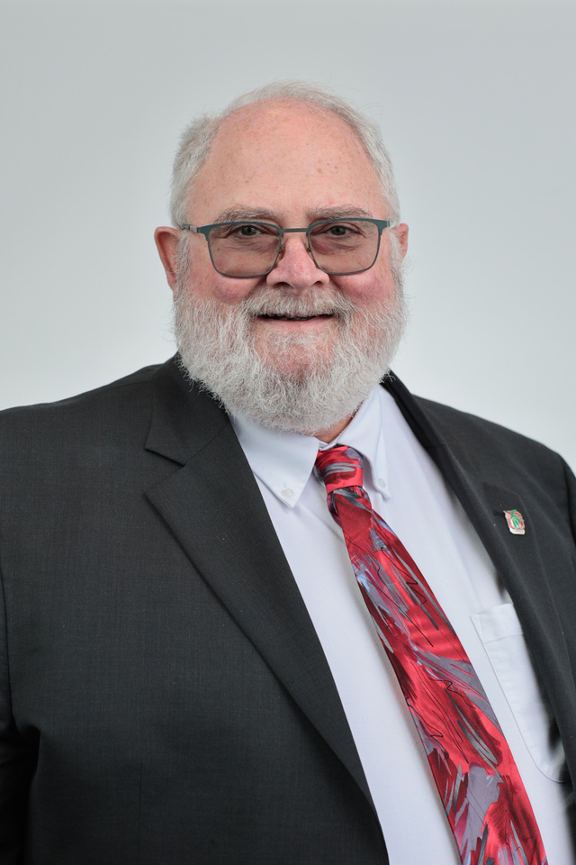
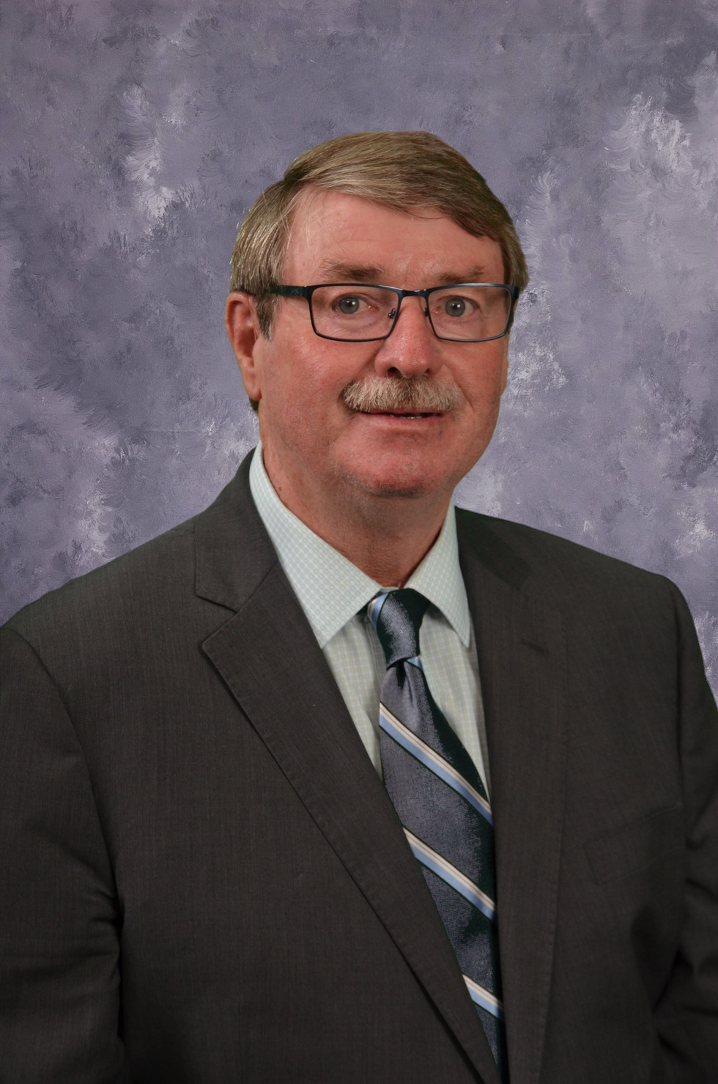
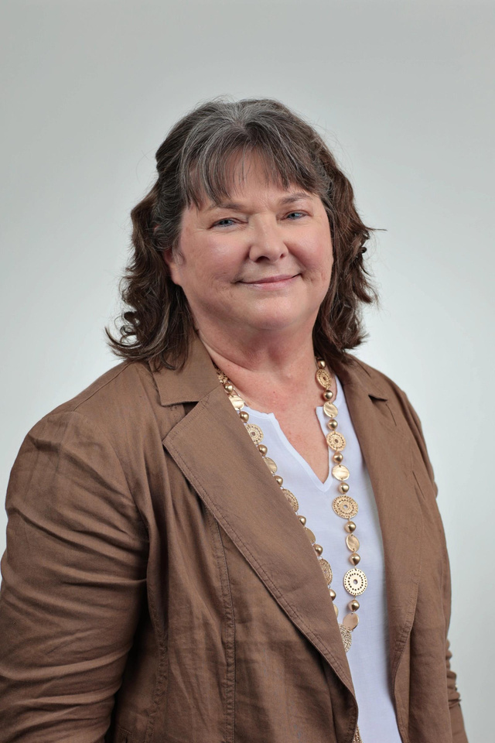
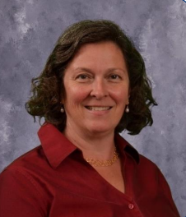
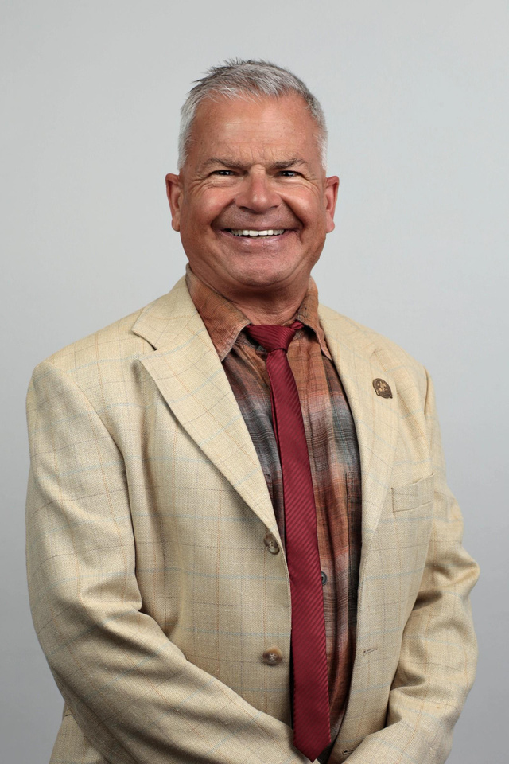
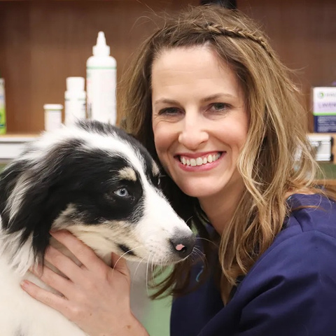
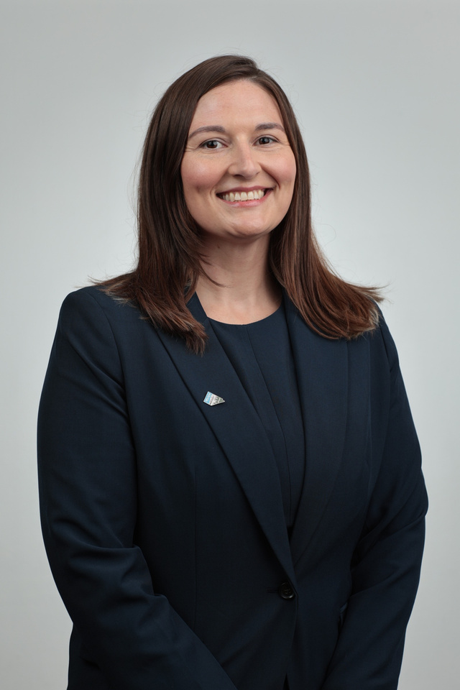
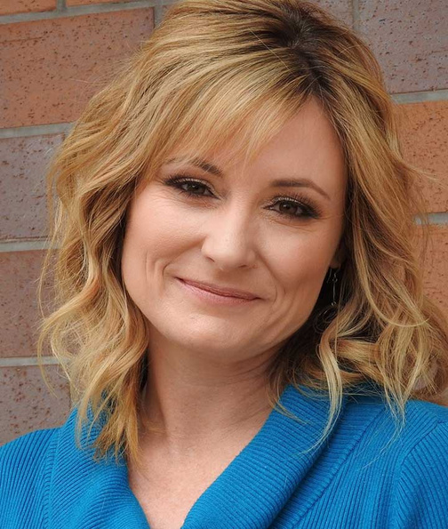
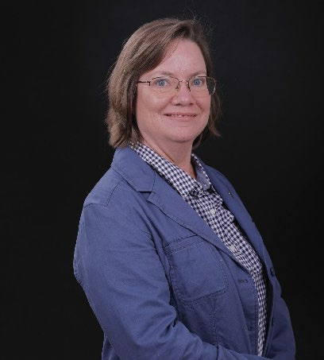
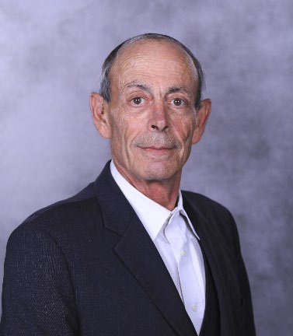
YOUR AAVSB BOARD OF DIRECTORS
This Board provides strategic insight into emerging issues that may affect veterinary medical regulation, helping ensure we are prepared and proactive.
PRESIDENT
IMMEDIATE PAST PRESIDENT
PRESIDENT-ELECT
TREASURER
DIRECTOR
Timothy Kolb, DVM
(Ohio)
Frank Richardson, DVM
(Nova Scotia)
Sheila Dodson, DVM
(Kansas)
Amy Haywood, LVT
(District of Columbia)
Mark Chmielewicz, DVM
(New York)
DIRECTOR
DIRECTOR
DIRECTOR
DIRECTOR
DIRECTOR
Holly Lunsford, DVM
(Oklahoma)
Jennifer Pedigo, EMBA
(Nevada)
Christina Bradbury, DVM (California)
Robin Lazaro, RVT (North Carolina)
Michael Pfander, DVM (Missouri)
Notes:
This slide to be the Assessment Life Cycle similar to PSI's slide 3.
Use the icons of the steps to carry over to upcoming slides.

Slide 4



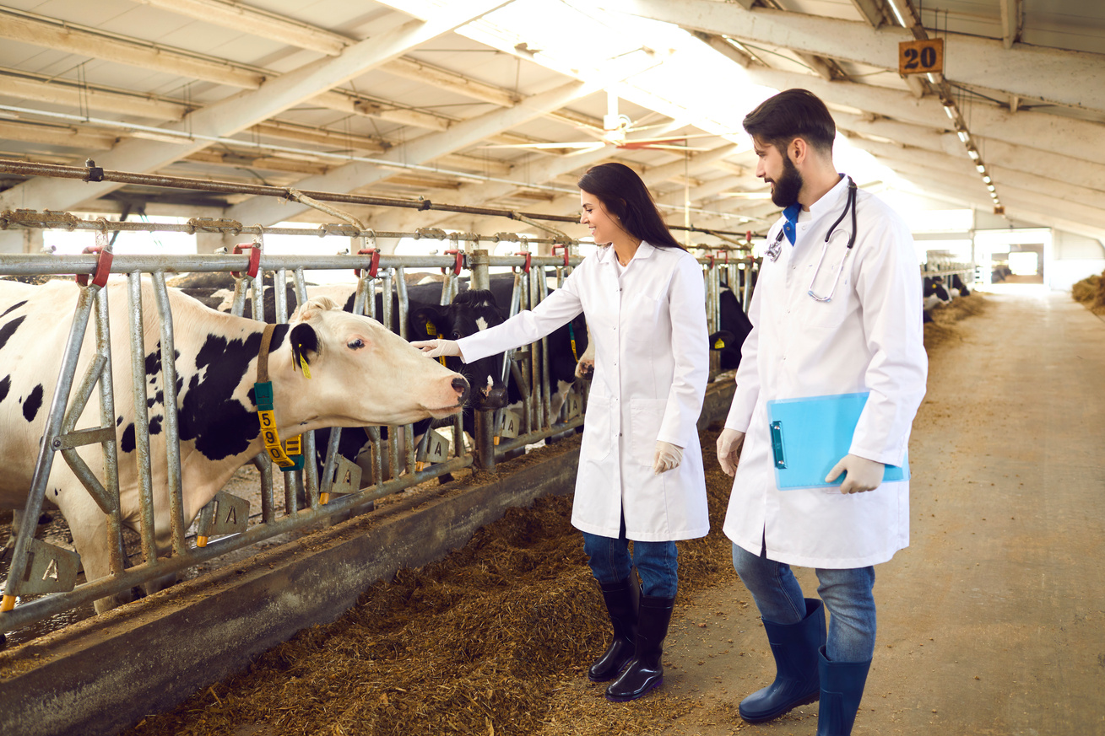
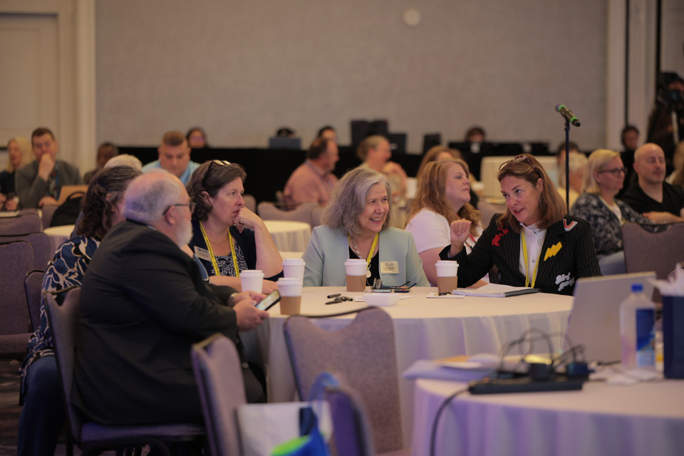
BENEFITS OF MEMBERSHIP
Core Purpose: To ensure and enhance the welfare of the public and animals.
Mission: The AAVSB’s leadership and comprehensive resources support and advance veterinary medicine regulation.
Administrative Support
Regulatory Education & Training
Disciplinary Notifications
Statute &
Rule Model Language
Networking
& Support

Slide 5







OVERVIEW OF ADMINISTRATIVE SUPPORT
BENEFITS
OF YOUR
MEMBERSHIP
Veterinary Information Verification Agency
Veterinary Application for Uniform Transfer
Registry of Approved Continuing Education
All Members get access to the AAVSB Proprietary Services and Administrative Support
Registry of Approved Continuing Education
Program for the Assessment of
Veterinary Equivalence
State & Provincial Assessments
Veterinary Technician National Exam

Slide 6
THE VIVA DATA EXCHANGE PROGRAM
WHY IT MATTERS
BOARD VALUE
HOW TO PARTICIPATE
  Access the most up‑to‑date, verified licensure information—faster, more precise decisions
  Digital exam score transfers for earlier access and reduced processing time
  Secure API infrastructure improving speed, accuracy, and data protection
  Data matching ensures VIVA reflects your exact license types and statuses
  Reduces administrative burden and strengthens public protection
  Quicker evaluations and applicant processing
  Fewer manual steps and less staff workload
  Increased confidence in data used for regulatory decisions
  Supports modernization and operational efficiency
  API Database-to-Database Connection (real-time automation)
  Concierge Bulk License Data Uploads (no IT resources required)
SUPPORT & STANDARDS
  AAVSB will support your IT costs
  AAVSB will provide a template for your IT department to get started

Slide 7
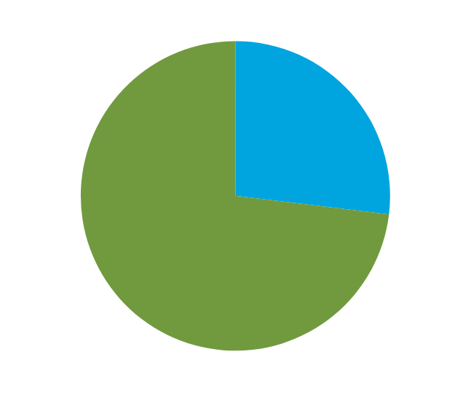
DISCIPLINARY NOTIFICATIONS
MULTIJURISDICTIONAL CREDENTIAL STATUS OF INDIVIDUALS REFERENCED ON DISCIPLINARY REPORTS
DR. F
Was involved in the horse doping case, disciplined in PA, (notifications sent to DE, FL, IN, NJ, NY, OH), FL website shows complaint and license revoked, OH website shows “Board Action: Pending”.
DR. G
Was involved in the horse doping case, disciplined in KY based on Federal Case, KY discipline sent to FL Board, FL website shows a complaint issued earlier this month.
DR. C
Falsified log entries dispensing controlled substances to their deceased dog, failure to report DWI to TX board; license revoked in CA and CO, Probation in TX. CA and CO disciplines reported to TX.
DR. B
Disciplined in MO with 5-year probation and anger management in Feb 2023; Mar 2023 discipline report sent to KS Board; May 2023 licensee applied for renewal in KS and did not disclose discipline on their renewal application, but KS board had received notification of discipline through AAVSB; KS issued stipulation and consent order.
Notes:
This slide to be the Assessment Life Cycle similar to PSI's slide 3.
Use the icons of the steps to carry over to upcoming slides.

Slide 8
VAULT SERVICES:
Giving your Board Trusted Info & Time Back
AAVSB’s secure licensure data exchange—built for members
Reports personalized to your jurisdiction so scores are reported in the format you need
Saves your board staff time and effort by verifying and consolidating licensure documents
Your go-to source for questions about licensure requirements between jurisdictions
Gives you peace of mind, knowing the score reports you receive are official and verified
Secure portal to access data - giving your board one location to go for VAULT information
WE do the verification work, so YOU can be more effective and efficient.
Notes:
- VAULT’s score reports always reflect the standard reporting format for your jurisdiction. For example, some of your statutes still refer to scores on a 70- or 75-point scale. VAULT automatically converts those scores for you
- You never have to play the guessing game with VAULT scores. In the area of AI-generated images, you can rest assured that when score reports come from VAULT, they are the official and verified scores.
- We know how many demands are placed on your board’s staff. VAULT reduces that workload, so they can continue focusing on the job at hand.
- Our portal also provides a one-stop-shop for exam scores. Instead of waiting for multiple documents to come in the mail, your board knows there is one, secure place to find what they need.
- Finally, you can save time when trying to understand different licensure requirements. Ask our staff if you’re ever researching requirements among other jurisdictions. Odds are, we already have the answers ready for you.
In short, WE do the verification work, so YOU can be more effective and efficient.

Slide 9




HOW VAULT PREMIUM WORKS
Candidate submits VAULT application, authorizing VAULT to make requests
VAULT requests primary source documents from issuing institutions
Primary source documents sent to VAULT & stored in VIVA database
Board can directly access documents through the
AAVSB portal
Notes:
- Of the three VAULT services, VAULT Premium offers your board additional benefits.
- Here is an overview of how the process works, so your board can rest assured that the information you receive is verified and comes directly from the source.
- Our VAULT staff goes through a rigorous process to request, obtain, and verify primary source documents like license verifications and transcripts.
- No more receiving one license verification here, another one on a different day, then going back and forth with a licensee about the right way to submit their transcript. When you receive a VAULT Premium, you receive direct access to those primary source documents all in one place and all at the same time.

Slide 10
RACE® AND RACETRACK®:
Member Value Through CE Quality & Oversight
A member‑driven solution for CE standards and consistency
Establishes uniform national standards for veterinary continuing education
Provides an independent quality review of CE programs without requiring board‑level course evaluation
Allows providers to voluntarily apply and comply with clearly defined RACE standards
Preserves jurisdictional authority—boards retain final decision‑making on CE acceptance
Widely recognized across U.S. and Canadian jurisdictions, supporting licensee mobility
Member Benefit:
Boards gain confidence in CE quality while avoiding duplicative review work and maintaining regulatory control.

Slide 11

RACE® AND RACETRACK®:
Operational Efficiency & Modern Regulation
Centralized tools that reduce administrative burden
CE Tracking & Data Access
  Centralized CE tracking improves verification at renewal
  Reduces manual audits, incomplete submissions, and disputes
CE Tracking & Data Access
Provider & Program Management
  Centralized provider and program review reduces board workload
  Less staff time spent on provider inquiries and CE vetting
Bottom Line
Provider
& Program Management
Strategic
Value
Strategic Value
  Strengthens regulatory consistency across jurisdictions
  Supports AAVSB’s broader licensure data ecosystem
  Lays groundwork for future interoperability and modernization
Bottom Line
RACE helps boards regulate more efficiently today while supporting a forward‑looking, member‑led regulatory infrastructure.

Slide 12
PAVE®:
A Member-Driven International Licensure Pathway
Supporting boards in evaluating internationally educated veterinarians
Centralized evaluation of international veterinary education equivalence administered by the AAVSB on behalf of participating boards
Structured, standardized assessment process (credential verification, knowledge assessment, evaluated clinical experience) aligned with North American licensure expectations
Reduces board administrative burden and regulatory risk by eliminating independent review of complex international credentials
Preserves full jurisdictional authority—boards choose whether to accept PAVE and retain all licensure decision‑making
Supports public protection and workforce needs through a controlled, defensible pathway for internationally educated veterinarians
Member Value: PAVE enables boards to responsibly expand licensure pathways while maintaining consistent standards, operational efficiency, and regulatory control.

Slide 13
SPA JURISPRUDENCE EXAM:
Efficient, Secure Exam Delivery for Member Boards
The AAVSB manages exam logistics—eligibility coordination, payment, access, accommodations, and scoring
Online administration of state and provincial jurisprudence exams
Secure, standardized delivery supports defensible licensure decisions
Preserves full board authority over content, eligibility, and licensure outcomes
Reduces board administrative burden and operational costs
Member Value:
SPA allows boards to meet jurisprudence requirements efficiently while maintaining regulatory control and public protection, at no cost to the Member Board.

Slide 14
AAVSB MEMBER SERVICES:
Comprehensive Support for Effective Vet Regulation
Member Value:
The AAVSB membership strengthens regulatory effectiveness by combining expert support, modern infrastructure, and shared solutions—so boards can protect the public and advance veterinary medicine with confidence.
Regulatory Support & Expert Guidance
Knowledge Center & Regulatory Resources
ListServ
A private, members‑only forum where Executive Directors and Registrars connect to ask questions, share solutions, and learn from peers—plus a searchable archive of past discussions.
Access model regulations, best practices, policy insights, and personalized staff support for complex regulatory questions.
Use a centralized hub for templates, regulatory guidance, committee tools, and inter‑board collaboration—saving time and improving consistency.
Education, Training, Networking & Collaboration
Board Meeting Engagement & Support
Membership Onboarding & LifeCycle
Equip board members and staff through the Annual Meeting & Conference, Board Basics & Beyond, workshops, and targeted leadership training.
By participating in jurisdictional Board meetings, we support education and share insight into national trends and discussions shaping veterinary regulation.
Member Services supports Affiliate Members throughout their journey—providing onboarding, guidance, and ongoing lifecycle support.

Slide 15


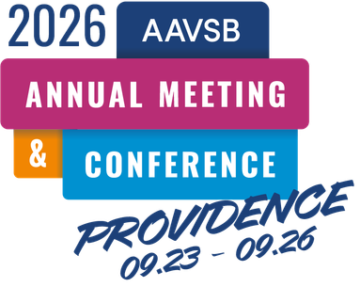


MEMBERSHIP VALUE:
In-Person Meetings & Webinars
In‑Person Engagement (We Cover the Cost)
Exchange solutions and perspectives by examining operational models and regulatory practices from other jurisdictions.
Supporting new board members in understanding their responsibilities as regulators.
Brings members together to learn, collaborate, and shape the future of their profession through shared governance and peer connection.
Virtual Learning & Collaboration
VetBoard
Quarterly Affiliate Member Roundtables
  Safe, peer‑to‑peer discussions for individuals in similar roles
  Space to:
    Discuss shared challenges across jurisdictions
    Exchange solutions and strategies
    Celebrate successes and innovative work
Held Quarterly:
May 13th
August 12th
November 11th
Year‑round access to timely education and best‑practice sharing
Connect
For
Member
Boards
Notes:
This slide to be the Assessment Life Cycle similar to PSI's slide 3.
Use the icons of the steps to carry over to upcoming slides.

Slide 16


MODEL DOCUMENTS & WHITE PAPERS
Veterinary Medicine and Veterinary Technology Practice Act Model
(PAM) with Commentary
Model Regulations: Scope of Practice for Veterinary Technicians and Veterinary Technologists
Model Regulations:
Appropriate Use of Opioids
CREATED BY REGULATORS FOR REGULATORS
Guidance Document for CBD Use on Companion Animals: United States
Guidance Document for CBD Use on Companion Animals: Canada
Model Regulations: Telehealth & Virtual Practice of Veterinary Medicine & Veterinary Technology
Model Regulations: Establishment and Maintenance of a Veterinarian-Client-Patient-Relationship
Model Regulations:
Safe Haven Program

Slide 17

VOLUNTEERING WITH THE AAVSB
Volunteering with the AAVSB is a meaningful way to contribute to the future of veterinary medicine while growing professionally.
Make an impact by shaping policies, programs, and initiatives that support veterinary regulation nationwide
Share your expertise through diverse Committees and Task Forces focused on real‑world regulatory challenges
Stay ahead of emerging issues such as telemedicine, licensure, allied health, and evolving practice models
Learn from peers by collaborating with leaders from jurisdictions across the country
Grow professionally through leadership development, networking, and broadened perspective

Slide 18

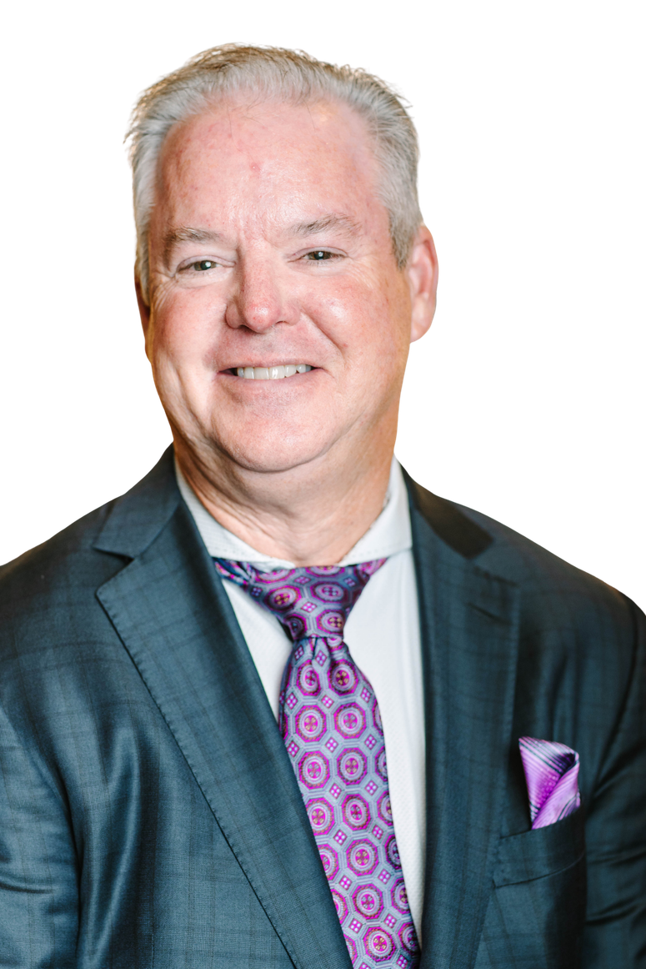
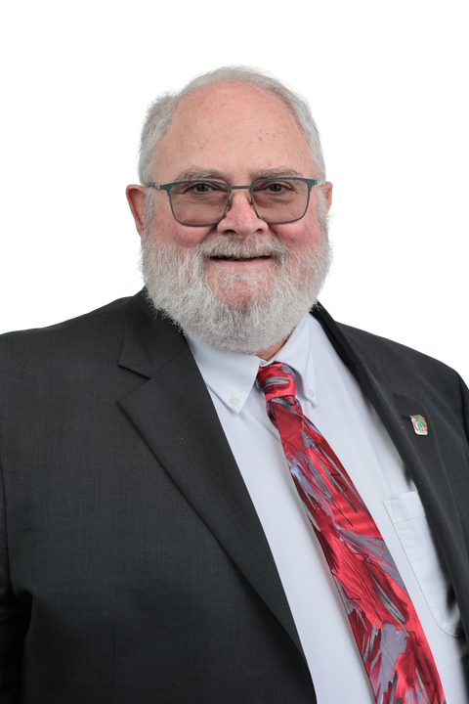
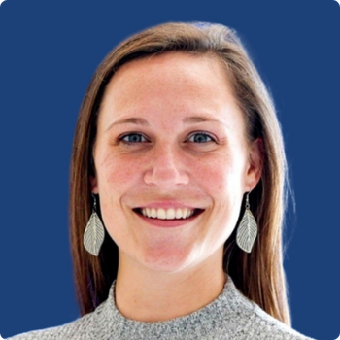
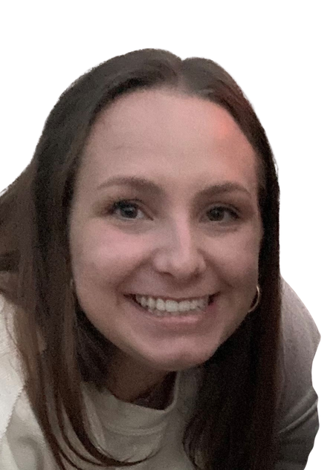
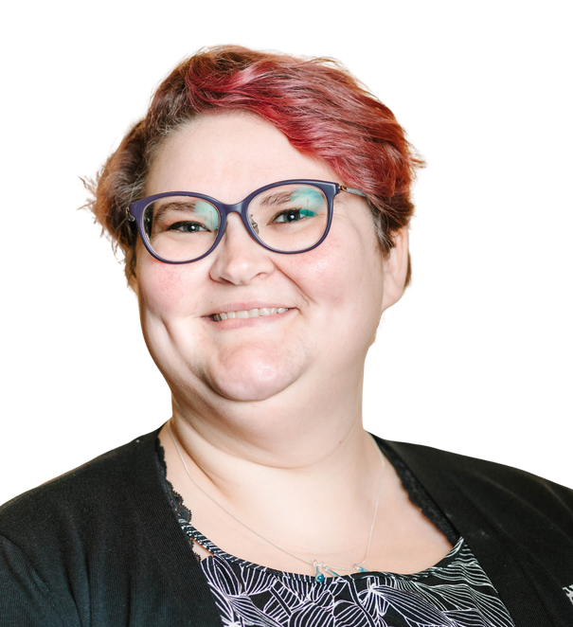
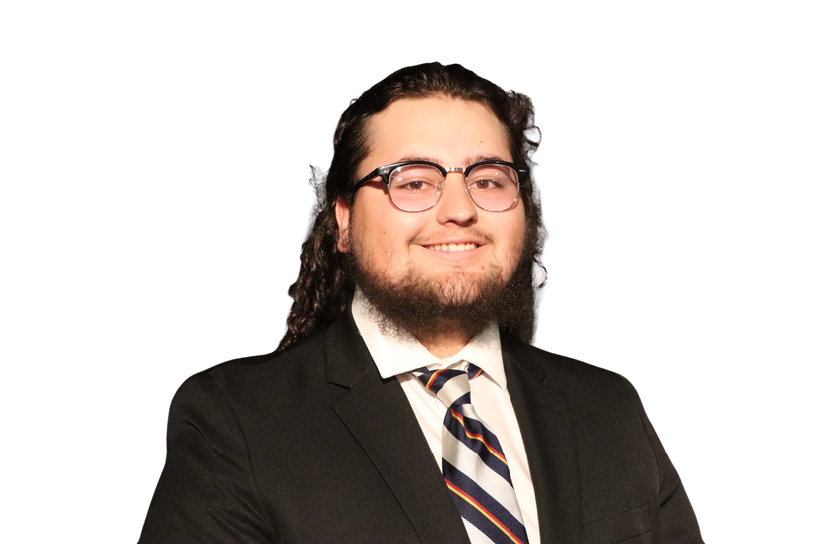
Your Support Team
Jim Penrod
Dr. Tim Kolb
CEO, AAVSB
President, AAVSB Board of Directors
MEMBER SERVICES
MEMBERSERVICES@AAVSB.ORG
Rachel Novak
Member Services Manager | rnovak@aavsb.org
Courtney Schweedler - Teel
Member Board Relations Specialist | cschweedler-teel@aavsb.org
Kat Bryant
Member Data & Technology Associate | kbryant@aavsb.org
Lucas Prater
Member Engagement & Communications Associate | lprater@aavsb.org

